Slide 1
Regression in R
Data services @ HSL
Marieke k jones, phd
Marieke@virginia.edu

Slide 2
Outline
Linear models and Multiple regression
Measures of model fit
Logistic (and Multinomial regression)
Mixed effects models
Variable selection

Slide 3
Linear regression
Simple linear regression
With a Categorical Variable (ANOVA)
Covered last class
With a Continuous Variable (review)
Multiple regression
Can seamlessly combine categorical and continuous predictors

Slide 4
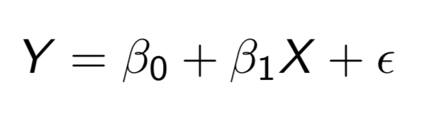
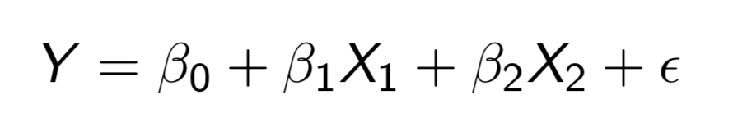
Linear regression
Single predictor X
Multiple predictors X₁ and X₂
Y = response variable
X = predictor
β₀ = y-intercept
β_{1,2} = slope. What effect does one unit change in X do to Y?
ϵ = residual error
Given X, slope, and y-intercept, model cannot perfectly predict Y. These are assumed to be normally distributed with a mean of 0 and a standard deviation σ

Slide 5
Linear regression

Slide 6
Assumptions of linear regression
Random Sampling
Residuals are independent
Residuals are normally distributed
X and Y have linear relationship
Residuals show constant variance across levels of X

Slide 7
Measures of model fit
R² / Adjusted R²
RMSE (Root Mean Squared Error)
AIC / BIC
Special case: compare 2 nested models
Likelihood Ratio test

Slide 8
Measures of model fit
R²
Percentage of variation in Y explained by model
Increases with number of predictors
Adjusted R²
Proportion of total variance explained by model
Increases with number of predictors if improvement in model fit is worthwhile
RMSE (root-mean-square error)
Square root of the mean of the squared residuals
Indicates absolute fit of the model to the data
How close are observed data to model’s predicted values
Lower values indicate better fit
Best measure of model fit for predictive models

Slide 9
Measures of model fit
AIC / BIC
Akaike Information Criterion / Bayesian Information Criterion
Estimate relative quality of models for a given set of data
When a model is used to represent a process that generated data, some information will be lost by using the model rather than the process itself
AIC / BIC estimate relative information lost by a given model
Include a tradeoff between model fit and model complexity
Lower is better
The optimal model has a high R², low RMSE, and low AIC / BIC

Slide 10
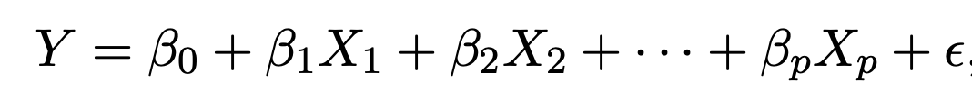
Multiple regression
Rarely can biological phenomena be explained by one variable
Simple extension of linear model with 1 predictor
Can add continuous and / or categorical predictors
** Interpretation of coefficient is “average effect on Y of a one unit increase in Xj, holding all other predictors constant”

Slide 11
Multiple regression Tips
Use biological knowledge to inform which predictors are included
Do not add predictors that correlate too highly with other predictors (~+/- .8)
The addition of new predictors will change the model fit and coefficients of other predictors

Slide 12
Logistic and multinomial regression
Outcome variable is binary → logistic regression
e.g. model whether someone is insured based on several other variables
Model log odds of being insured
Outcome variable is categorical (3+) → multinomial regression

Slide 13
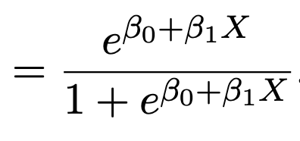
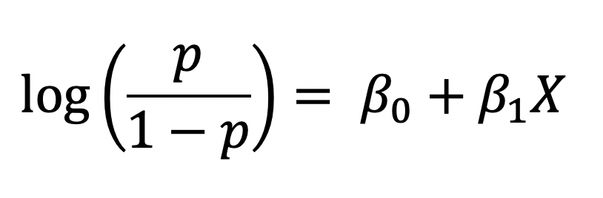
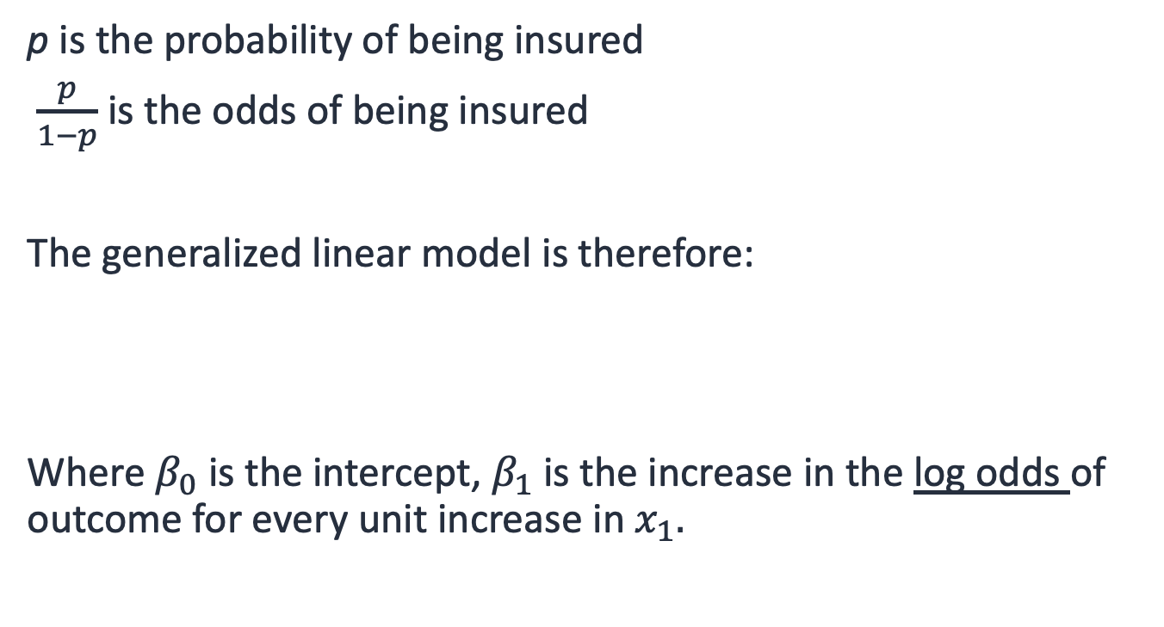
Logistic regression
p is the probability of being insured
$\frac{p}{1−p}$ is the odds of being insured
The generalized linear model is therefore:
Where $β_{0}$ is the intercept, $β_{1}$ is the increase in the log odds of outcome for every unit increase in $x_{1}.$
p

Slide 14
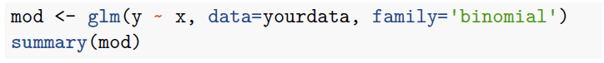
Logistic regression
Logistic regression is a type of generalized linear model (GLM)
using glm() function in R
glm() works like lm() except we specify which distribution to use with the family argument
Logistic regression uses family=binomial

Slide 15
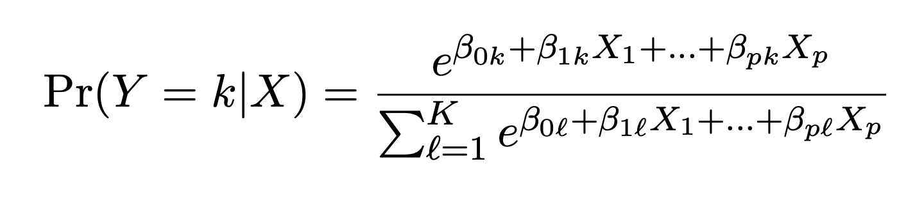
Multinomial regression
Extension of logistic regression where each class (k) is modeled by its own linear function
multinom() function in nnet package
Tutorial at https://stats.idre.ucla.edu/r/dae/multinomial-logistic-regression/

Slide 16
Mixed effects regression
Linear model with both fixed effects and random effects
LME (Linear Mixed Effects) models are suitable for clustered, longitudinal, or repeated measures data where data are grouped by random levels and response variable is continuous
Random levels means that there are observations that belong to single subject or group that can be thought of as randomly selected from the population
Fixed effects have estimates of their effect on Y (slope / coefficient)
Random effects have estimates of variation

Slide 17
Mixed effects regression
Example: Treatment applied to subjects and outcome measured every 2 weeks for 2 months
Treatment is a fixed effect. Other fixed effects could be age, sex, cell type, time. If we were to repeat this experiment, we would use these variables again
These data are grouped by subject. The subjects we choose are a random sample from the population, so there are random effects associated with subjects. If we repeated the experiment, we would not use these subjects again
In R: lmer() function in lme4 package and lmerTest package
May need glht() function in multcomp package for multiple comparisons

Slide 18
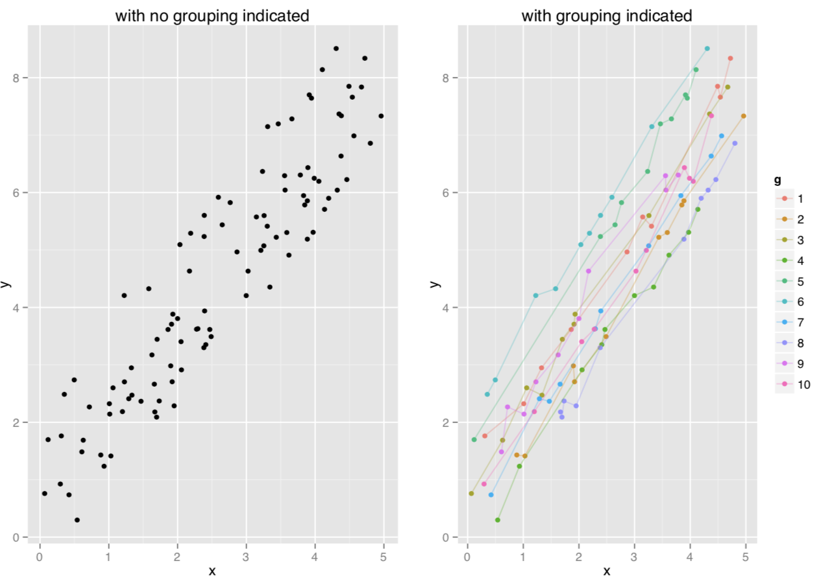
Need for mixed effects

Slide 19
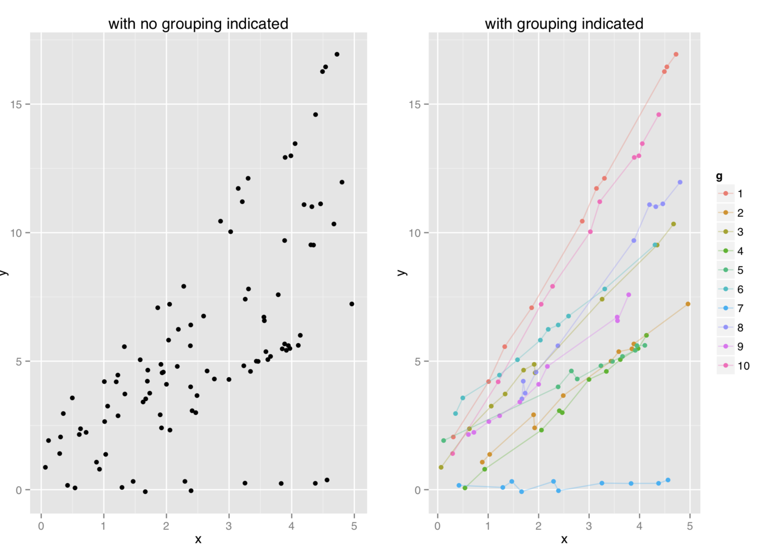
Need for mixed effects

Slide 20
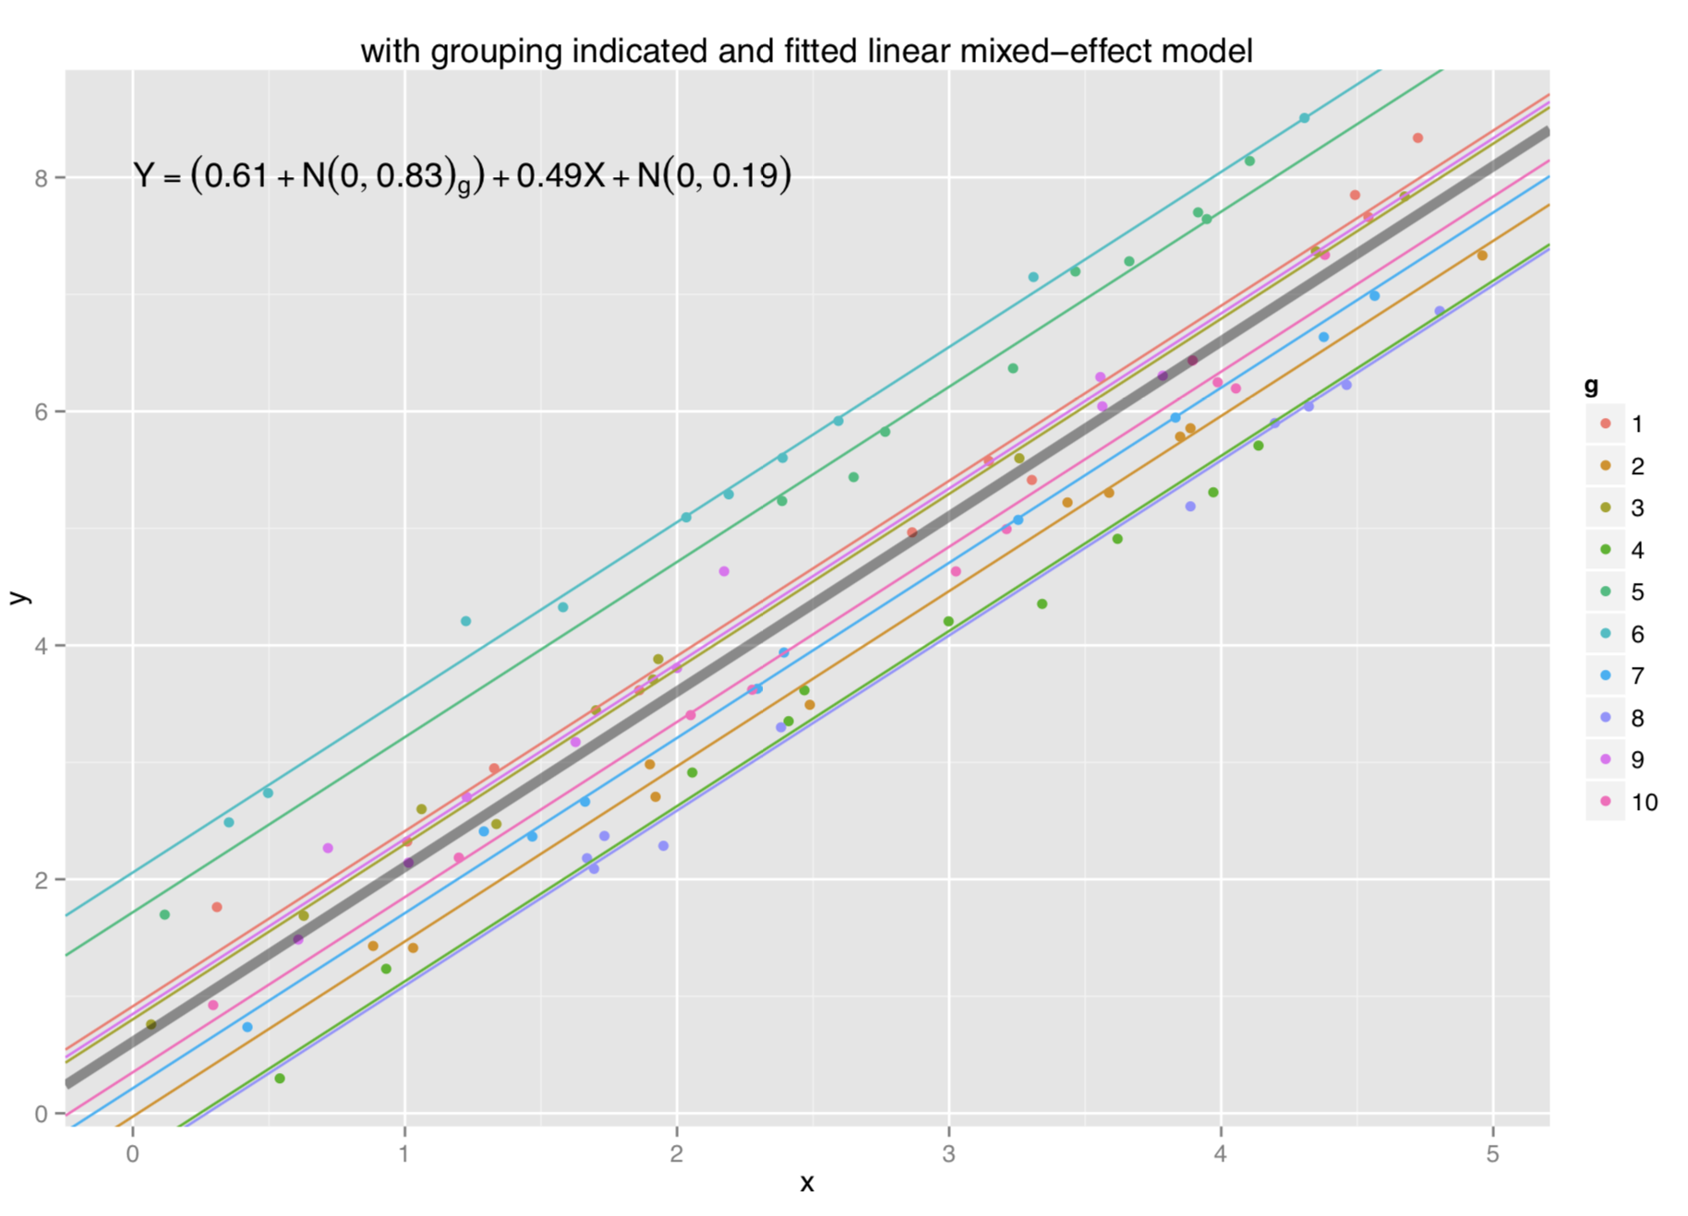
Same slope, different intercept

Slide 21
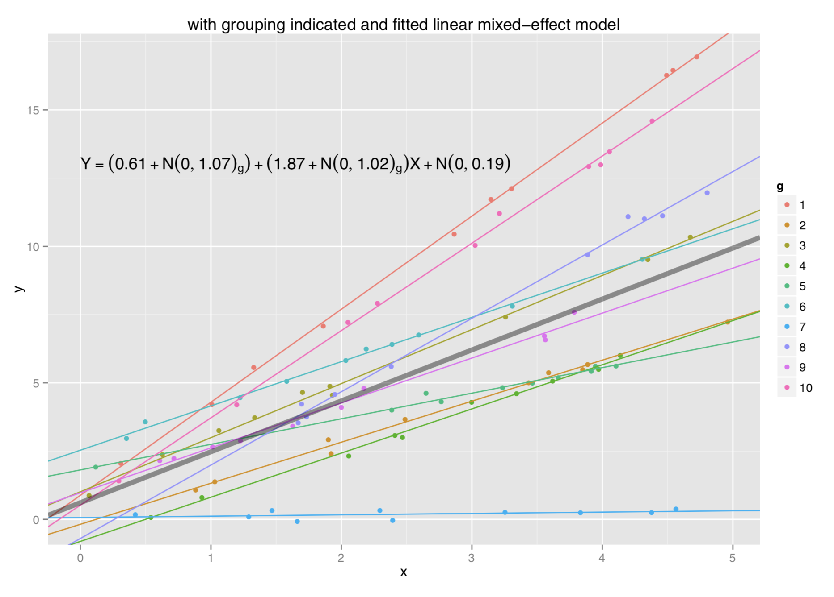
Different slope, different intercept

